Slide 1
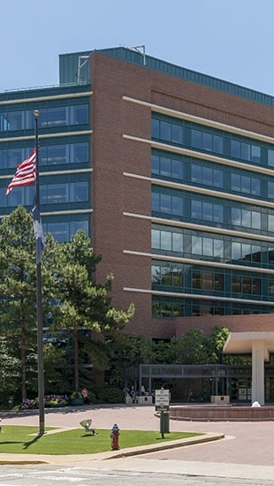


OPPORTUNITY REVIEW
DIRECT-TO-EMPLOYER GTM STRATEGY
Exploring a SRHS DTE Health Plan

Slide 2


Founded in 1979, headquartered in Indianapolis
Largest Independently-Owned Full-Service Third-Party Administrator
Specialize in Administration of Self-Funded Plans and Population Health Management​
Leader in the Direct-to-Employer Movement
We Know and Understand the Market
Experience Working with All Professional Teams: Agents, Networks, MGAs
The Key Family of Companies is a Vertically Integrated group of benefit related organizations
3,000+ Corporate Clients
3 Million Members under Management
700 Employees

Slide 3


MARKET LEADER
IN
PRIVATE LABELED
DTE PLANS
Louisville, KY
OneHealth Plan
Cincinnati, OH
TCH Optimal
Bentonville, AR
Northwest Health Plan
Knoxville, TN
East Tennessee Health Plan
Meridian, MS
Affinity Health Plan
Fort Myers, FL
Lee Health Care Partners

Slide 4
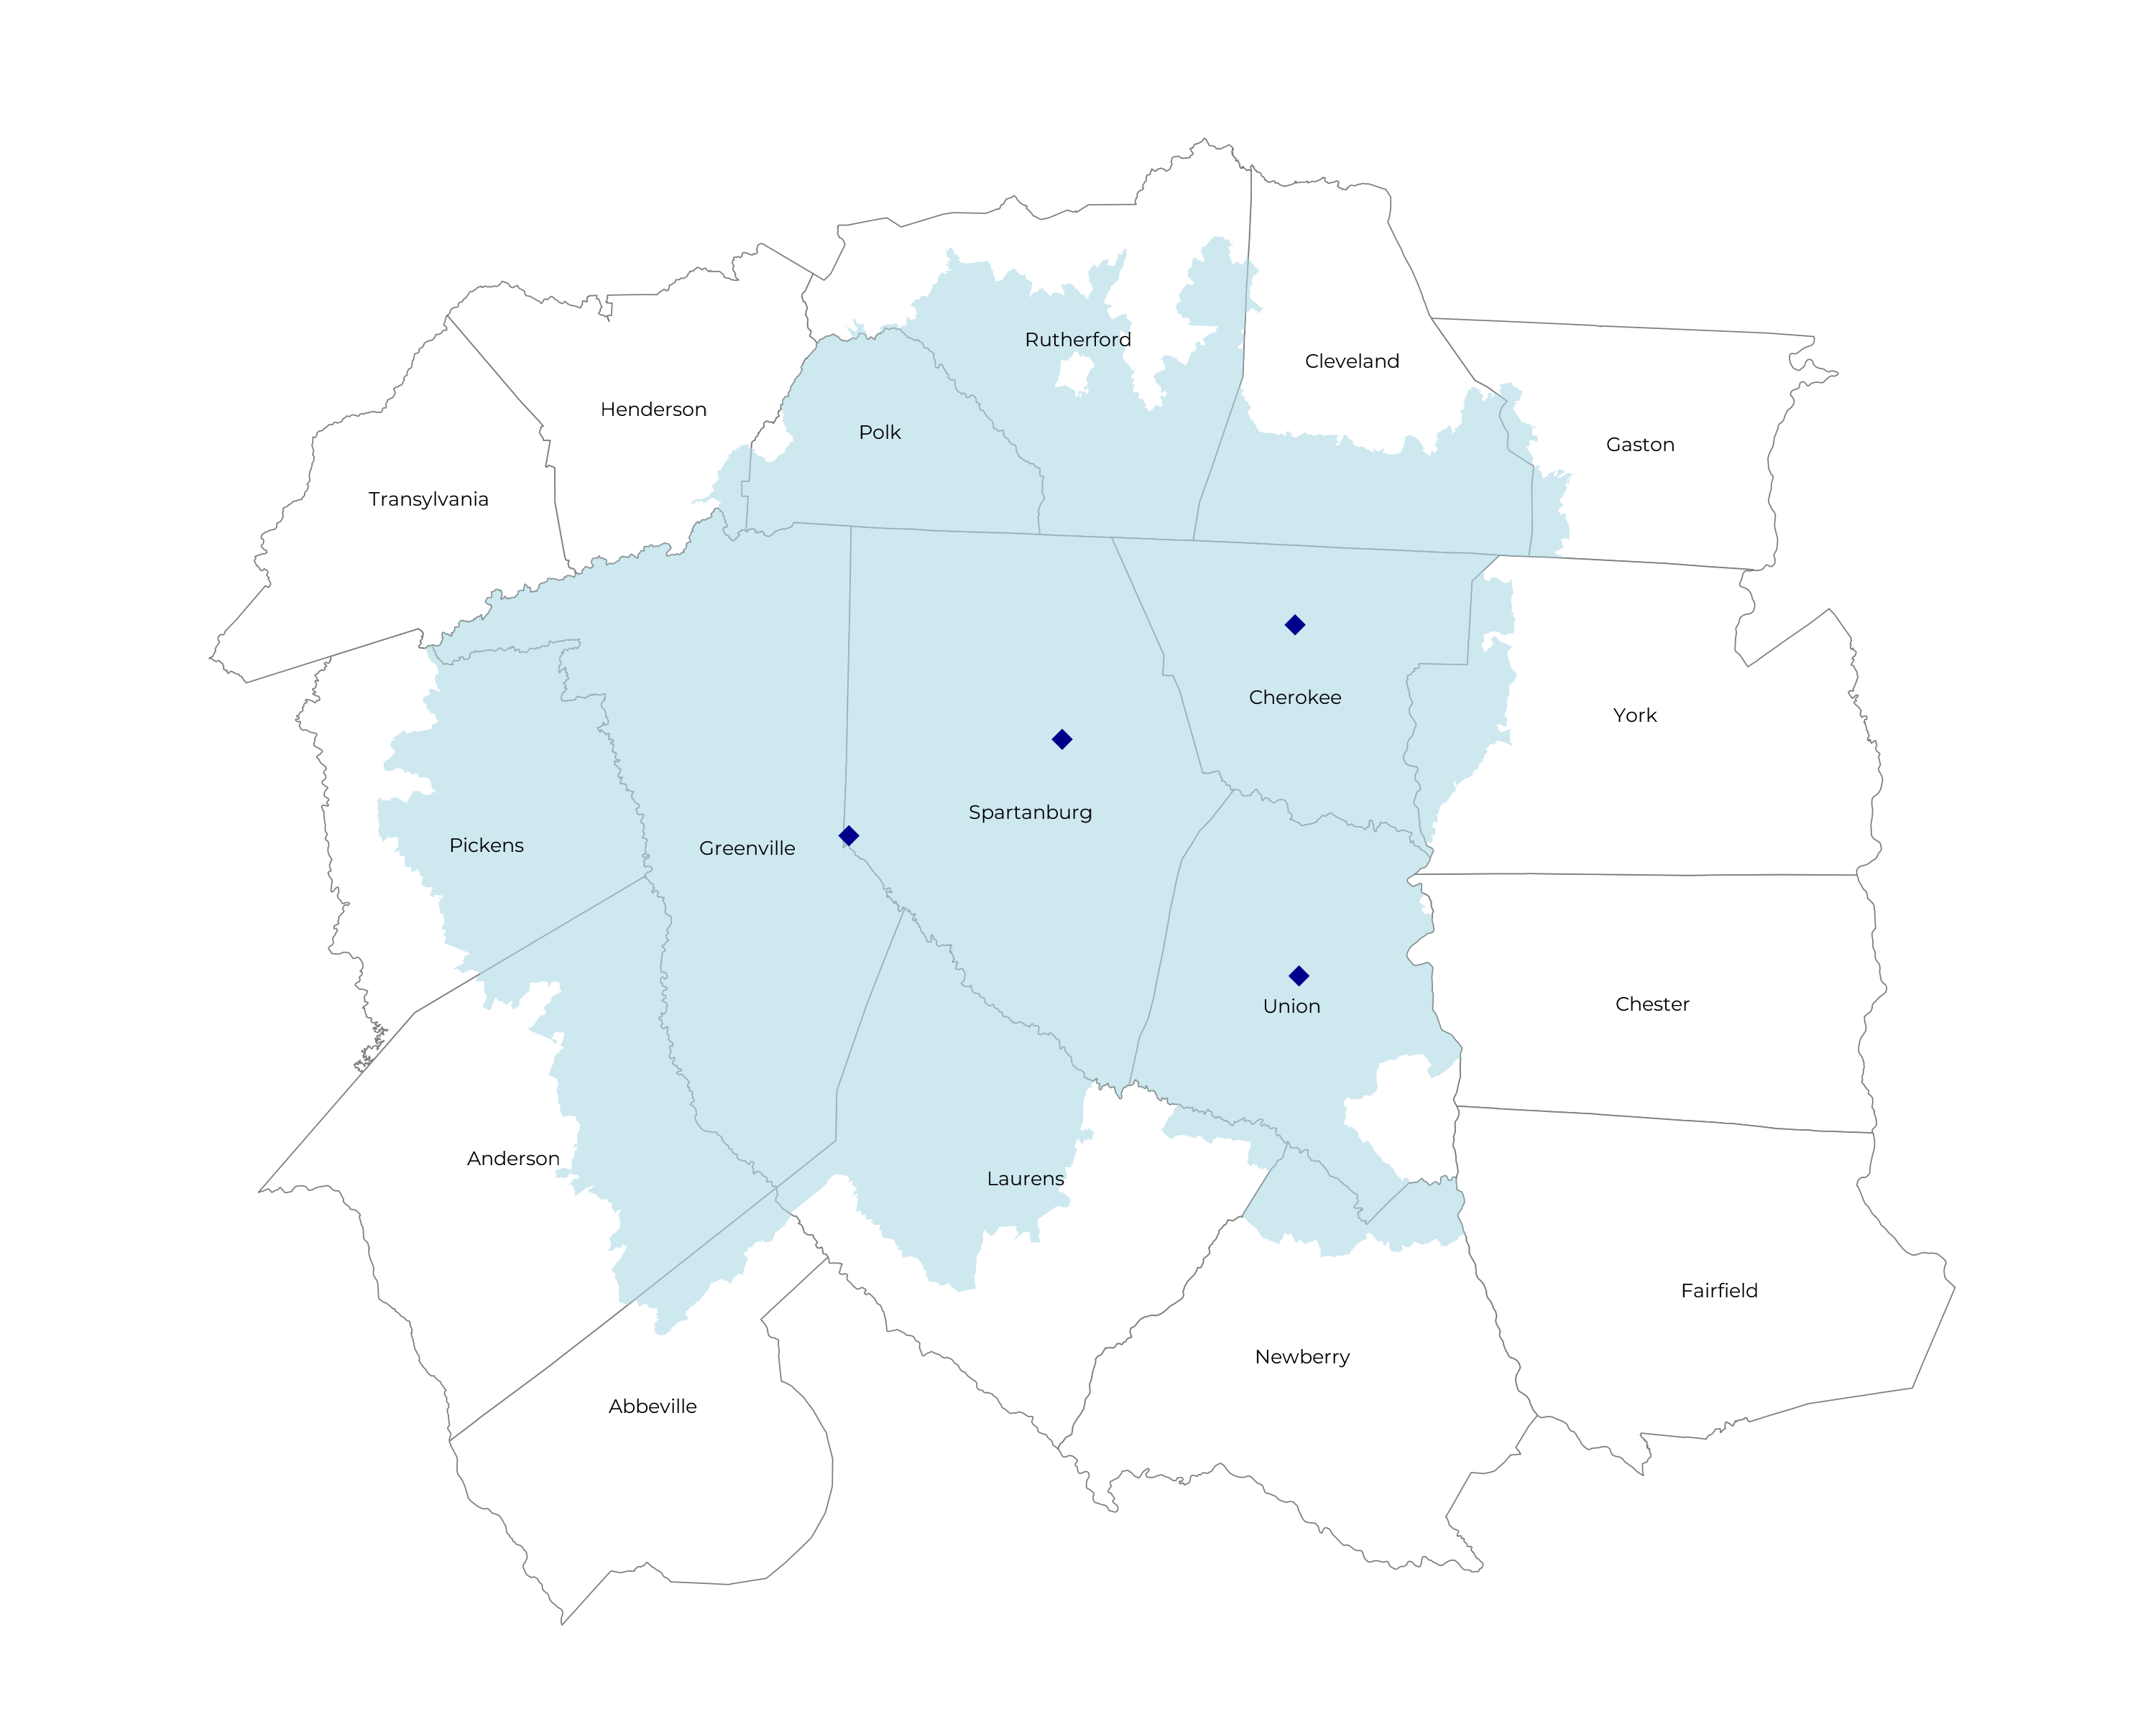
SIGNIFICANT OPPORTUNITY FOR PLAN GROWTH Researched for the below highlighted service area
Self Funded
322K
Insured
505K
Working Age
736K
Population
1,256K

Slide 5
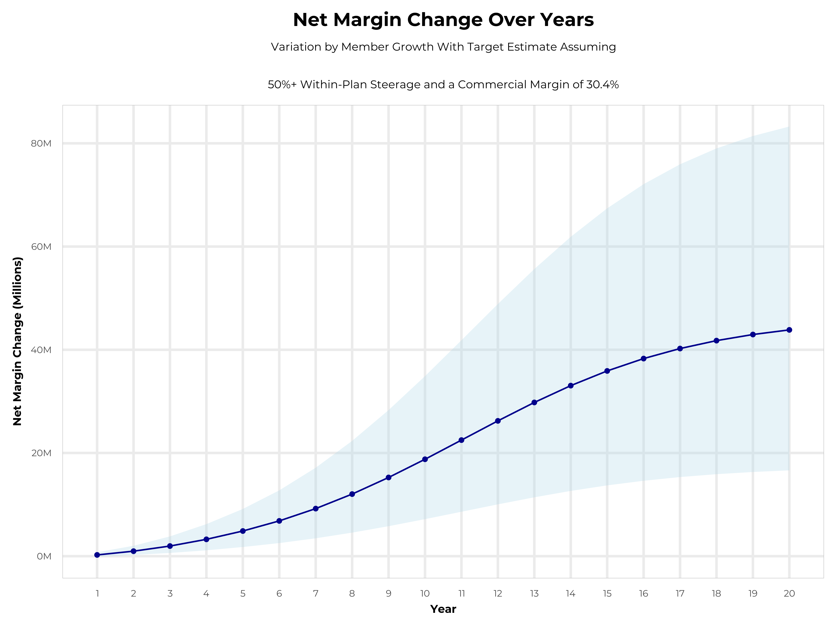
GROWING POWERFUL, LASTING PROFITABILITY
Early Stage
Gaining Name Recognition, Early Growth
New Revenue:
New Profit:
$10.47M
$3.03M
Growth Stage
Strong Reputation, Strong Growth
New Revenue:
New Profit:
$62.58M
$19.11M
Mature Stage
High Profitability, Market Saturation
New Revenue:
New Profit:
$128.61M
$39.43M

Slide 6
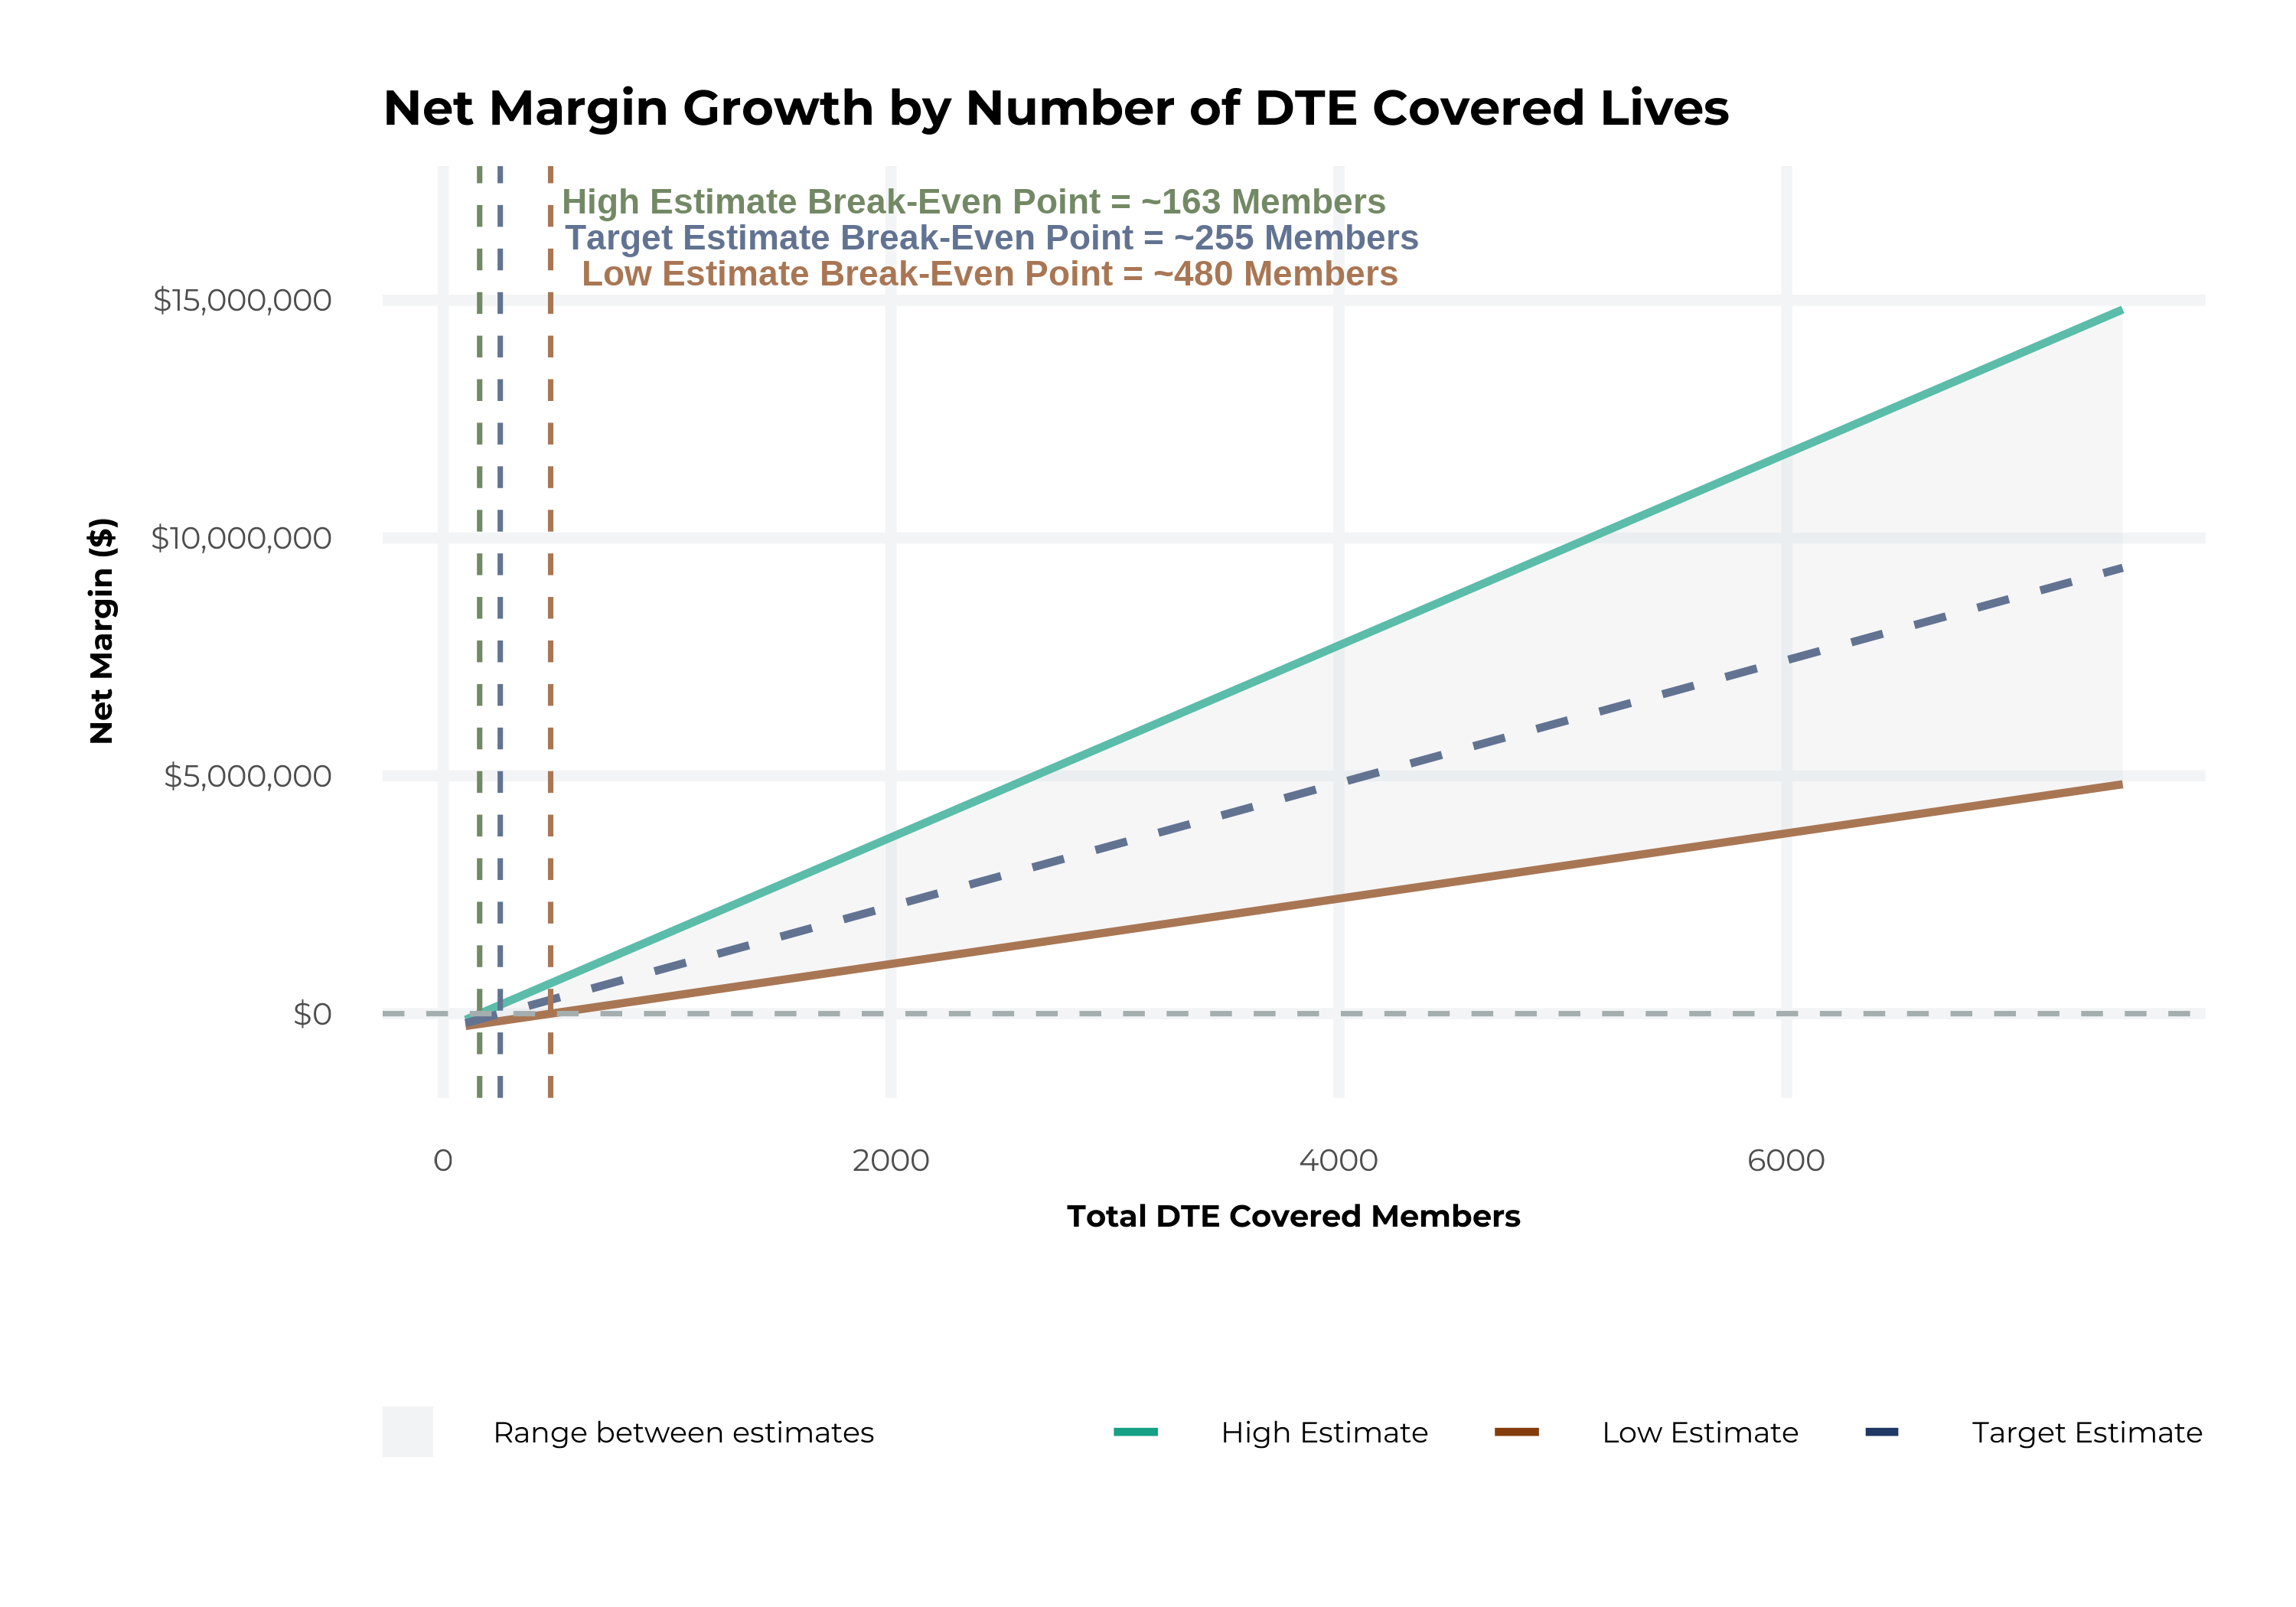
MODEL ASSUMPTIONS AND BREAK EVEN
Patient Steerage Assumptions
KBA currently estimates that Spartanburg Regional Healthcare System has 28% inpatient market share, and 13% outpatient market compared to hospitals/clinics in the Spartanburg Regional Healthcare System service area (see slide 4). The DTE tiered structure will create immediate steerage, with additional steerage over time from patient bonus benefits and the patient card (see slide extended analysis for estimates of target steerage).
Low
High
10% below target
10% above target
Commercial Margin Assumptions
KBA observes a SRHS 38% commercial margin. Conservatively, we model the DTE to be even with commercial rates given prices 10% below market, but with a 10 percentage-point increase through friendlier billing practices and improved patient collections with the patient card.
Low
Target
High
25.4%
30.4%
35.4%

Slide 7
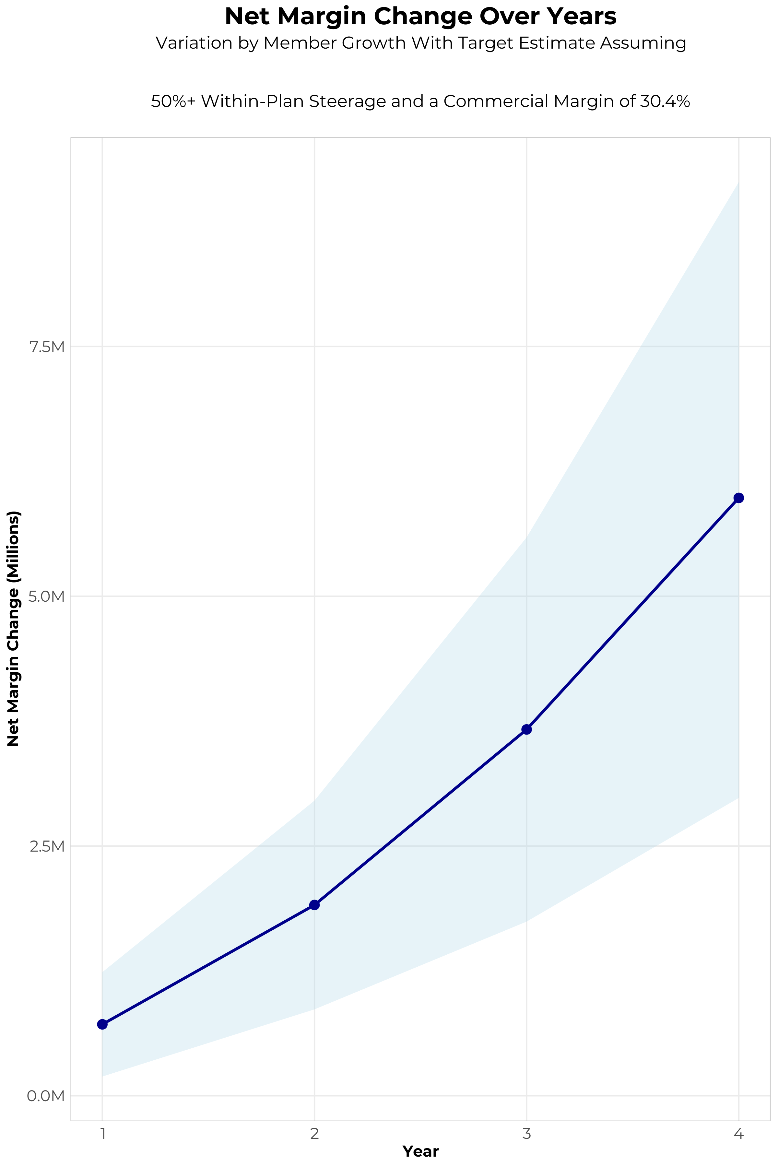
FOUR-YEAR PROJECTIONS
Target Member Growth | Target Member Growth | Target Member Growth | Target Member Growth | Target Member Growth
Metric | Year 1 | Year 2 | Year 3 | Year 4
Number of Members | 800 | 1,600 | 2,600 | 3,900
Incremental Margin | 1,035.2K | 2,070.4K | 3,815.4K | 6,117.6K
Network Access Fee | 9.6K | 19.2K | 31.2K | 46.8K
Implementation Fee (One-Time) | -150.0K | 0.0K | 0.0K | 0.0K
Sales and Marketing Costs | -180.0K | -180.0K | -180.0K | -180.0K
Net Margin Change | 714.8K | 1,909.6K | 3,666.6K | 5,984.4K
High Member Growth | High Member Growth | High Member Growth | High Member Growth | High Member Growth
Metric | Year 1 | Year 2 | Year 3 | Year 4
Number of Members | 1,200 | 2,400 | 3,900 | 5,900
Incremental Margin | 1,552.8K | 3,105.6K | 5,723.1K | 9,254.8K
Network Access Fee | 14.4K | 28.8K | 46.8K | 70.8K
Implementation Fee (One-Time) | -150.0K | 0.0K | 0.0K | 0.0K
Sales and Marketing Costs | -180.0K | -180.0K | -180.0K | -180.0K
Net Margin Change | 1,237.2K | 2,954.4K | 5,589.9K | 9,145.6K
Low Member Growth | Low Member Growth | Low Member Growth | Low Member Growth | Low Member Growth
Metric | Year 1 | Year 2 | Year 3 | Year 4
Number of Members | 400 | 800 | 1,300 | 2,000
Incremental Margin | 517.6K | 1,035.2K | 1,907.7K | 3,137.2K
Network Access Fee | 4.8K | 9.6K | 15.6K | 24.0K
Implementation Fee (One-Time) | -150.0K | 0.0K | 0.0K | 0.0K
Sales and Marketing Costs | -180.0K | -180.0K | -180.0K | -180.0K
Net Margin Change | 192.4K | 864.8K | 1,743.3K | 2,981.2K

Slide 8

DIRECT-TO-EMPLOYER STRATEGY: ONLY AVAILABLE TO PREMIER HEALTH SYSTEMS
STRONG Brand Quality
EXTENSIVE Patient Access
AFFORDABLE Value Pricing
EXCELLENT Care Quality

Slide 9
SRHS IS PATIENT RECOMMENDED
Health System | HCAHPS Recommendation Percentile | CMS Stars Percentile | Mortality Percentile | Readmission Percentile | KBA Brand Quality Score
Spartanburg Regional Healthcare System | 58 | 35 | 63 | 71 | 64
Prisma Health | 48 | 65 | 67 | 77 | 62
Advocate Health | 24 | 61 | 60 | 68 | 53
LifePoint Health | 16 | 61 | 65 | 76 | 50
Based on quality measures and HCAHPS feedback, KBA estimates that SRHS has a competitive brand compared to health systems in Cleveland, Polk, Rutherford, Anderson, Cherokee, Greenville, Laurens, Newberry, Pickens, Spartanburg, Union, and York Counties.

Slide 10
SINGLE YEAR SUMMARY
DTE Covered Members Financial Analysis | DTE Covered Members Financial Analysis | DTE Covered Members Financial Analysis | DTE Covered Members Financial Analysis | DTE Covered Members Financial Analysis | DTE Covered Members Financial Analysis | DTE Covered Members Financial Analysis | DTE Covered Members Financial Analysis
Target Estimate Assuming 50%+ Within-Plan Steerage and a Commercial Margin of 30.4%. | Target Estimate Assuming 50%+ Within-Plan Steerage and a Commercial Margin of 30.4%. | Target Estimate Assuming 50%+ Within-Plan Steerage and a Commercial Margin of 30.4%. | Target Estimate Assuming 50%+ Within-Plan Steerage and a Commercial Margin of 30.4%. | Target Estimate Assuming 50%+ Within-Plan Steerage and a Commercial Margin of 30.4%. | Target Estimate Assuming 50%+ Within-Plan Steerage and a Commercial Margin of 30.4%. | Target Estimate Assuming 50%+ Within-Plan Steerage and a Commercial Margin of 30.4%. | Target Estimate Assuming 50%+ Within-Plan Steerage and a Commercial Margin of 30.4%.
DTE Members | Pre-DTE Revenue | Pre-DTE Margin | DTE Revenue | DTE Incr. Revenue | DTE Total Margin | DTE Incr. Margin | Net Margin Less DTE Fees
100 | $ 196K | $ 60K | $ 618K | $ 422K | $ 188K | $ 128K | $ -201K
500 | $ 982K | $ 299K | $ 3,091K | $ 2,109K | $ 940K | $ 641K | $ 317K
1,000 | $ 1,965K | $ 597K | $ 6,182K | $ 4,217K | $ 1,879K | $ 1,282K | $ 964K
2,500 | $ 4,912K | $ 1,493K | $ 15,455K | $10,543K | $ 4,698K | $ 3,205K | $ 2,905K
10,000 | $19,649K | $ 5,973K | $ 61,819K | $42,171K | $18,793K | $12,820K | $12,610K
20,000 | $39,298K | $11,946K | $123,639K | $84,341K | $37,586K | $25,640K | $25,550K
NOTE: Please see detailed financial analysis and assumptions used in extended analysis.
Financial projections do not include 340B contribution margin, which could represent $136 PMPM by optimizing 340B through Rx plan design, SRHS’s approved site(s) with network integration, and development of SRHS’s proprietary PBM program.

Slide 11
PROJECTED PLAN GROWTH
Year | Employees | Members | Percent of Members Choosing SRHS for Inpatient Care | Percent of Members Choosing SRHS for Outpatient Care
1 | 400 | 700 | 60% | 50%
2 | 900 | 1,600 | 60% | 50%
3 | 1,400 | 2,500 | 65% | 55%
4 | 2,200 | 4,000 | 67% | 58%
5 | 3,100 | 5,600 | 68% | 60%
6 | 4,200 | 7,600 | 68% | 60%
7 | 5,600 | 10,100 | 69% | 61%
8 | 7,200 | 13,000 | 69% | 62%
9 | 9,000 | 16,200 | 69% | 62%
10 | 11,000 | 19,800 | 70% | 63%
11 | 13,000 | 23,400 | 70% | 63%
12 | 15,000 | 27,000 | 70% | 64%
13 | 16,800 | 30,200 | 71% | 64%
14 | 18,400 | 33,100 | 71% | 65%
15 | 19,800 | 35,600 | 71% | 66%
16 | 21,000 | 37,800 | 72% | 66%
17 | 21,900 | 39,400 | 72% | 66%
18 | 22,600 | 40,700 | 72% | 67%
19 | 23,100 | 41,600 | 72% | 67%
20 | 23,500 | 42,300 | 72% | 67%
KBA currently estimates that Spartanburg Regional Healthcare System has 28% inpatient market share, and 13% outpatient market compared to hospitals/clinics in the Spartanburg Regional Healthcare System service area (see slide 8).
Based on previous DTE experience, KBA expects a significant bump in patient steerage to Spartanburg Regional Healthcare System.
Additional steerage will occur from additional steerage patient benefits and the patient card.
High estimates start nearly 10% higher than target with low estimates at 10% lower than target

Slide 12
YEAR 4 PROJECTED REVENUE AND PROFIT
Pre-DTE Cohort of 3,900 Employees | Inpatient | Outpatient | Professional | Total
Revenue† | $ 3,445,427 | $ 2,875,010 | $ 1,342,605 | $ 7,663,042
Net Income‡ | $ 1,047,410 | $ 874,002.9 | $ 408,151.9 | $ 2,329,565
† Assuming proportional revenues from market shares of 28% (inpatient) and 13% (outpatient)
‡ Conservatively assuming a commercial margin of 30.4% (80% of the estimated commercial margin)
With DTE | Inpatient | Outpatient | Professional | Total
Revenue⁰ | $ 8,372,007 | $ 13,129,364 | $ 6,131,302 | $ 27,632,673
Net Income* | $ 2,545,090 | $ 3,991,327 | $ 1,863,916 | $ 8,400,333
⁰ Assuming 67% inpatient and 58% market steerage based on KBA narrow network DTE experience (see previous slide)
* Conservatively assuming a commercial margin of 30.4%, with a 10 percentage-point reduction to reflect competitive-edge rates and a 10 percentage-point increase due to lower billing costs and higher patient responsibility collections because of the member credit card.
Total Increase in Net Income | $ 6,070,768
Network Access Fee (Revenue) of $1 PMPM | $ 46,800
Total Profit Growth | $ 6,075,568
Minus Implementation Fee (One-Time) | -$ 0
Minus Sales and Marketing (Annual – Ongoing) | -$ 180,000
Total | $ 5,937,568

Slide 13





A PARTNER YOU CAN TRUST
OUR OBJECTIVES ARE ALIGNED
WE KNOW THE
MARKET
COMPLETELY TRANSPARENT
WE HAVE THE SOPHISTICATION AND INFRASTRUCTURE TO EFFECTIVELY COMPETE
Derek Moore, Senior Vice President – KBA
845-283-9973 * derek.moore@keybenefit.com

